Slide 1

BUILDING SUPPLY CHAIN EFFICIENCY
TWO BINS AT A TIME

Slide 2

Who We Are
BlueBin Inc. specializes in strategic supply chain solutions for healthcare organizations. Implementing the tools and philosophy of the Toyota Production System (TPS), we install a robust kanban system (BlueBin Technology) to immediately improve the hospital’s supply chain operations and drive continuous improvement.
Our mission is simple; to assist healthcare providers in
ensuring their staff have the supplies they need
to do their jobs everyday.

Slide 3

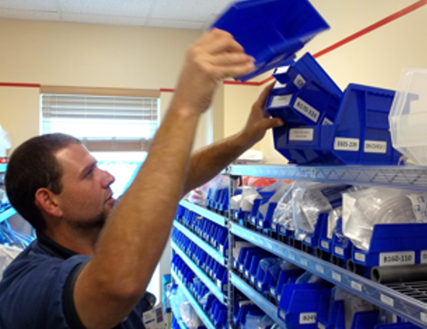

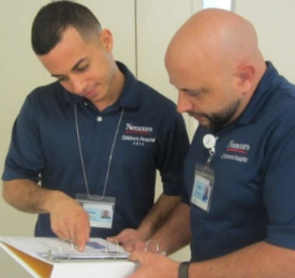



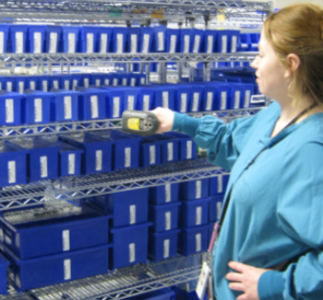

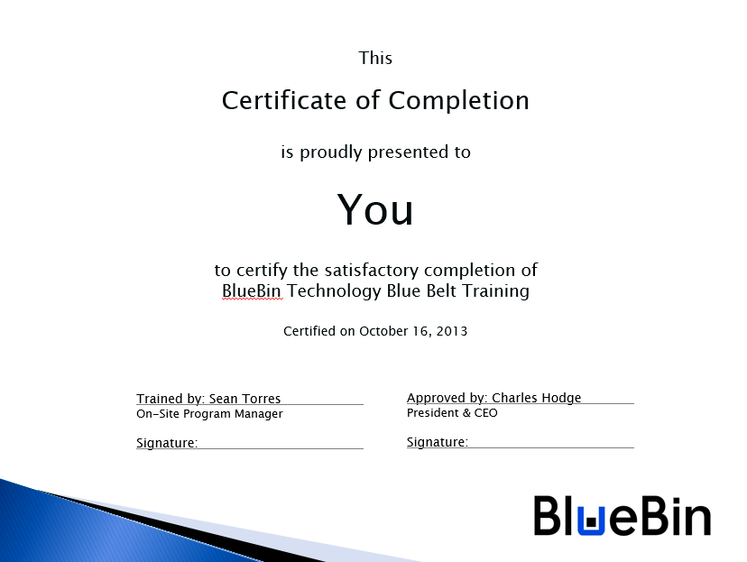
Daily Management System
Gemba Audits
Notes:
The daily management of the blue bin system is what sets us apart.
DMS is…
DMS Behavior:
Leaders as teachers
Expectation of improvement
Respect for people
Follow-up
Today’s focus is on Leadership Standard Work

Slide 4
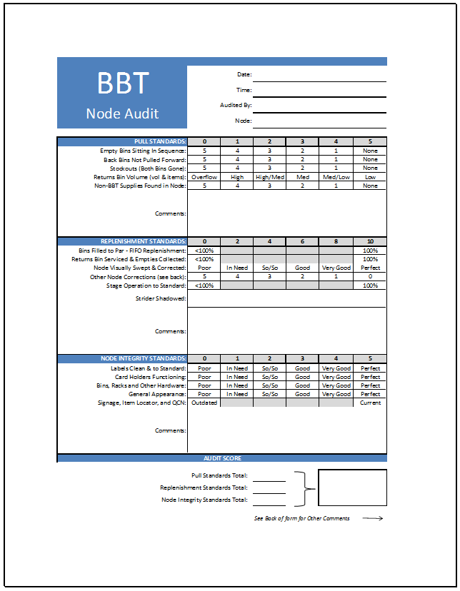
Gemba Audits
Critical component of the BlueBin Daily Management System (DMS)
Primary Function:
Acts as an instrument to evaluate operational performance and identify variance where BlueBin processes take place, primarily supply nodes and stage
Creates a call to action to address compliance infractions, maintain performance transparency, and gain knowledge about training needs with both direct and indirect organizational teams
Management Purpose:
Regularly takes leaders to the front lines to identify waste and opportunities to uphold expectations and foster continued improvement
Maintains the connection between daily work, cross-departmental relationships, and tiered-level accountability by “grading” 3 major categories of standard work

Slide 5

“Gemba” Defined
Gemba = Place
Genchi Genbutsu = Action
YOU ARE HERE
The real place
The place where value is created
The place where the work is being done
The place where customers use the product/service
Go and see what is really happening
Watch the process
Gain authentic understanding
Problem-solve based on visual evidence

Slide 6

Impact of “Go & See”
GO & SEE
Direct understanding of facts
Link with reality
Visible Interest
Front line motivation up
GO & STUDY
Direct engagement with people
Teamwork
Meaningful dialogue
Coaching
Role modeling
Capability build-up in 5WHYs problem-solving
New confidence in leaders’ roles
GO & SOLVE
I learn
They learn
We improve
We celebrate
Role modeling
High confidence in root cause analysis and application of countermeasures
High confidence in leaders’ support
CONTINUOUSLY IMPROVE
All reports with personally verified facts
Actions fully validated with front line
Continuous learning mindset cascaded to each leader level down to front line
IMPACT
RESULTS

Slide 7
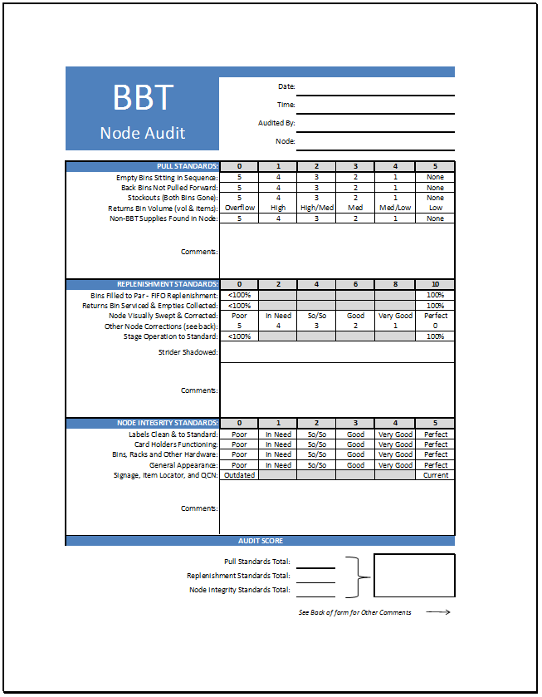
Audit Form Components
Auditor’s information
Clinical Compliance
Strider Compliance
Maintenance Compliance
Total Score

Slide 8
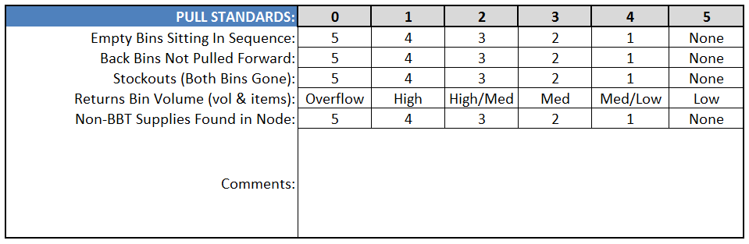
Clinical/Pull Standards
Utilize the comments area to capture “calls to action”
  Example – talk to clinical champion about dedicating a new space for staff’s personal items, constantly ending up in supply area
  Example – attend next unit huddle to explain the importance of pulling bins forward
Be aware of last time of node service, a full returns bins could mean a number of reasons
  Example – Not serviced by strider per standard work
  Example – Nurses grabbing too much initial supply, work with team to drill down on reasons/solutions
  Example – end of nursing shift, strider servicing happening soon

Slide 9
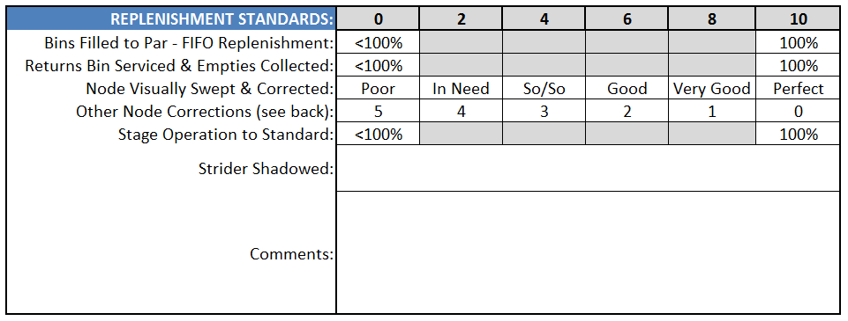
Strider/Replenishment Standards
For most accurate scoring, time this portion of the audit during/immediately following strider node service
  Make a visual sweep for FIFO replenishment, bins not rotated will be highly visible (front bin has more product than back bin)
Utilize the back of the audit page to capture any other service corrections needed
The stage portion applies only to the stage area for the node being audited, not stage in general (many save this as their final step of the audit process)

Slide 10
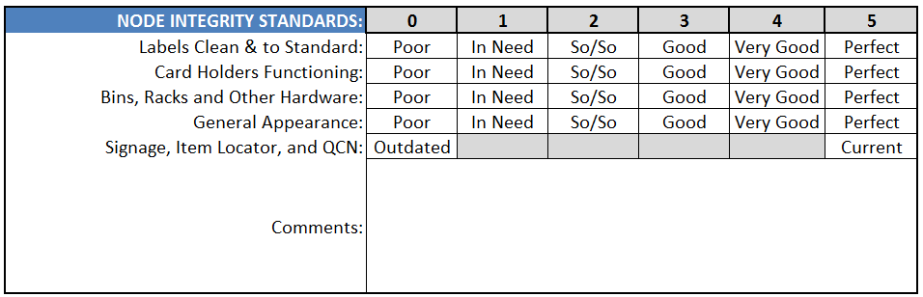
Maint./Node Integrity Standards
The cosmetic appearance of the nodes are as important as proper function
General wear and tear should always be “tuned up” by hospital Blue Belts
Any urgent issues should be captured on the team huddle board immediately following the audit

Slide 11
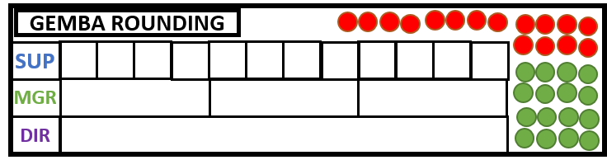
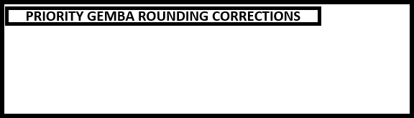

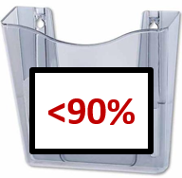
Close the Loop
Upon completion of node audits, calculate the average
If cumulative score is ≥90 (pass), a green dot is placed in the appropriate section
If cumulative score is <90 (fail), a red dot is placed in the appropriate section
Capture any critical needs that need to be addressed immediately
In Summary:
Update the huddle board
Drop audits in the appropriate bin
Talk about it
Take necessary action!
Drop individual audits in their respective pass/fail bins

Slide 12
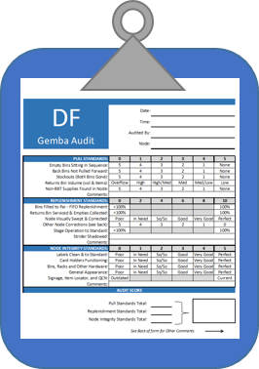
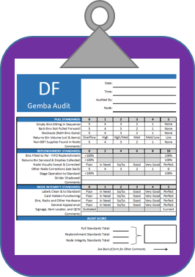
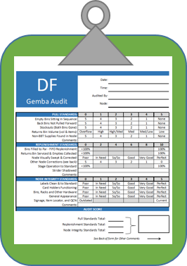
Who Audits and When?
Blue Belts/Sup:
All nodes Weekly
Director:
All nodes Quarterly
Manager:
All nodes Monthly
*Standard/recommended frequencies for node audits. Larger hospitals or those with 40+ nodes may wish to reduce frequency requirement, so long as all nodes are audited at least once within every given quarter.

Slide 13


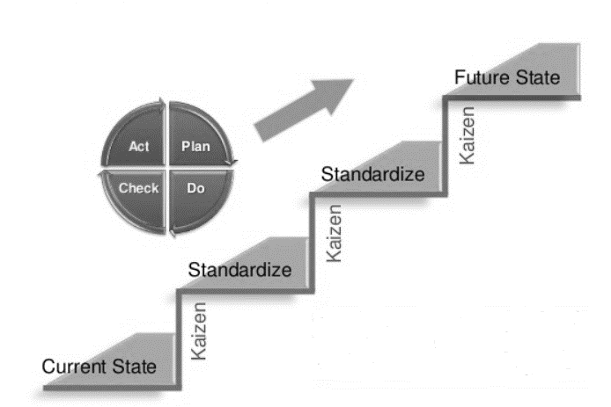

Summary – Gemba Audits
Its position in the DMS
A health indicator to evaluate clinical, strider, and maintenance teams’ adherence to standard work
Creates a call to action based on real findings – a powerful coaching tool
To uphold standard work and continuous improvement gains
To sustain quality, reliability, and service excellence, in tandem with hospital mission and vision statement

Slide 14











Questions Please
www.bluebin.com

